Slide 1

Spatial Data Management using Spatial Databases
Yao-Yi Chiang
Computer Science and Engineering
University of Minnesota
yaoyi@umn.edu
CC-BY
Attribution

Slide 2
What is Data Management?

Slide 3

How do you manage your photos?
Most cellphones take nice photos
Taking 3 photos a day will give you ~1,000 photos a year
Taking a 5-day vacation would give you 200 photos
Ways to managing photos
Leave them on the phone?
Organize them into folders?
Upload them to some cloud services?
Which method is the best?

Slide 4
How do you manage your photos?
Most cellphones take nice photos
Taking 3 photos a day will give you ~1,000 photos a year
Taking a 5-day vacation would give you 200 photos
Ways to managing photos
Leave them on the phone?
Organize them into folders?
Upload them to some cloud services?
Which method is the best?

Slide 5
Considerations for Managing Photos
Find photos by time
Find photos by subjects
Find photos by locations
Searching must be fast!
Photos need to be secure
Available resources

Slide 6
Data Management (Oracle)
Data management is the practice of collecting, keeping, and using data securely, efficiently, and cost-effectively.
help people, organizations, and connected things
optimize the use of data within the bounds of policy and regulation
(use data to) make decisions and take actions that maximize the benefit to the organization
https://www.oracle.com/database/what-is-data-management/

Slide 7
What are Some Data Use Cases for Spatial AI?

Slide 8









Trajectory Mining
Trajectories
Clusters
Mobility Behavior
Yue, M., Li, Y., Yang, H., Ahuja, R., Chiang, Y.-Y., and Shahabi, C. (December 2019). DETECT: Deep Trajectory Clustering for Mobility-Behavior Analysis. In Proceedings of the 2019 IEEE International Conference on Big Data (Big Data), pp. 988–997, Los Angeles, CA, USA

Slide 9
Do these two trajectories have the same moving behavior?
Shapes Distance
≠
1
2

Slide 10




With Geographical Context
Shapes Distance Sequence of activities
Resident
Business
Park
Raw Trajectory:
≠
With Context:
≈
1
2

Slide 11
Generate Geographic Context
Find nearby geographic features at each important location of a trajectory
Distance query

Slide 12
Database Management System

Slide 13

Database Management System (DBMS)
Persistence across failures
maintain a consistent system after failures – software, hardware, network failures, etc.
Concurrent access to data
Scalability to search on very large datasets (which do not fit inside main memories of computers)
Efficiency
https://www.flaticon.com/authors/eucalyp

Slide 14

Tables in Relational DBMS
A table describes the abstraction of a collection of things
e.g., cars, parking lot logs
A table can contain many columns and many rows
The table schema describes the metadata (columns) of these things (rows)
e.g., exist time
Values in one column share the same abstract data types
e.g., integer, floating points
Spreadsheet icons created by Freepik - Flaticon

Slide 15
IDs and Relations
Typically, one column, the primary key, contains the unique ID (identifier) of the described things
e.g., student IDs, social security numbers
This primary key column can exist in other tables to establish a relation
the foreign key
Relation
Car
Parking lot log
primary key
foreign key

Slide 16
Common Abstract Data Types (ABT)
Integers
1, 5, -2, 9,…
Floating points
0.12, -1.33, 2.459,…
Datetime
11/27/1988 1:11 PM PDT
String/Multi-characters
“Spatial AI is fun!”
Customized Domains
“Vehicle”, “Car”, “Truck”
Parking lot log
ID | Vehicle Type | Exit Time | Parking Fee
0 | Car | 9 am today | 2
1 | Truck | 1/9/2021 3:00 PM CDT | 2.5
2 | Minivan | Null | 3
3 | Wagon | 1/9/2021 3:00 PM CDT | 1.5
3 | Car | 1/3/2021 2:00 PM CDT
4 | Small car | 1/14/2021 5:15 PM CDT | Did not pay

Slide 17
Maintain Data Integrity
Car
Parking lot log
ID | Vehicle Type | Owner
0 | Car | David
1 | Car | Leilei
2 | Car | Hui
3 | Truck | Mary
4 | Truck | Peter
5 | Car | Raji
ID | Vehicle ID | Exit Time | Parking Fee
0 | 2 | 9 am today | 2
1 | 3 | 1/9/2021 3:00 PM CDT | 2.5
2 | 1 | Null | 3
3 | 2 | 1/9/2021 3:00 PM CDT | 1.5
3 | 5 | 1/3/2021 2:00 PM CDT
4 | 1 | 1/14/2021 5:15 PM CDT | 0
Also, take a look at database normalization on Wikipedia: https://en.wikipedia.org/wiki/Database_normalization

Slide 18

Index
Take (machine) time to build
Once built, help speed up data retrieval
Example:
Say you have collected paper questionnaires from 100 randomly selected students
Now you need to find information for a specific student using their student ID
How do you speed up the process?
Sort icons created by Freepik - Flaticon

Slide 19

Spatial Data Management System

Slide 20
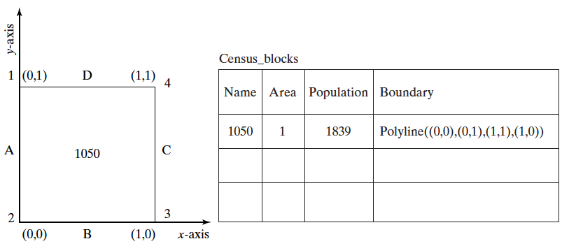
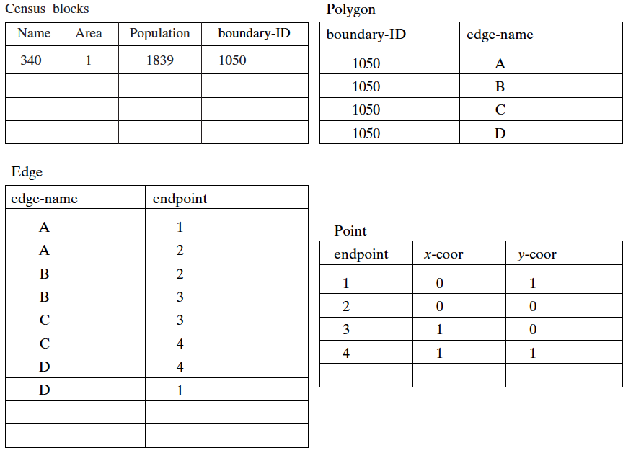
Model Spatial Data in Traditional DBMS
Use common ADTs, e.g., integer, string, floating points

Slide 21
Model Spatial Data in Traditional DBMS
How about this? What is the data type of the boundary column? String?

Slide 22
Model Spatial Data in Traditional DBMS
Can we do
Concat( Polyline((0,0), (0,1), (1,1), (1,0)), Polyline(1,0), (2,0), (2,1), (1,1)) )
And get Polyline((0,0), (0,1), (2,1), (1,0))
Or ask questions like
Area_Size(Polyline((0,0), (0,1), (1,1), (1,0))) = ?
And get 1
We can’t if the data type is String.
Polyline((0,0), (0,1), (2,1), (1,0))

Slide 23


Spatial Data Models
Spatial data models extends DBMS data models (i.e., requiring a DBMS engine)
Provide rules to identify identifiable objects and properties of space
Provide spatial data types at the atomic level, such as integer, string

Slide 24


Spatial Data Vector Model
Vector model: manage identifiable things with clear boundaries (or discrete locations), e.g., hotels, mountain peaks, cities, land-parcels
Point
Line
Polygon
Polygonal icons created by Voysla - Flaticon

Slide 25

Spatial Data Raster Model
Raster model: manage continuous and amorphous phenomenon, e.g., wetlands, satellite imagery, snowfall
Polygonal icons created by Voysla - Flaticon

Slide 26
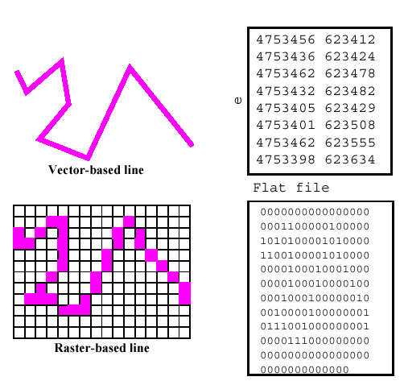
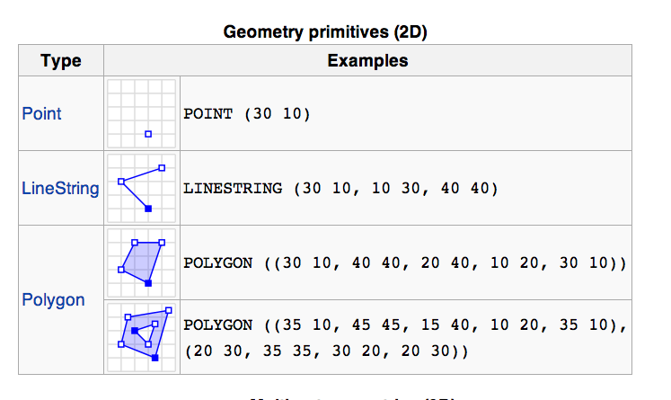
Raster and Vector Examples
Well-known text (WKT)

Slide 27
Support Common Spatial Data Operations
Direction queries
What is the nearest restaurant north of my current location?
Distance queries
What are the restaurants within a 1-mile radius
Topology queries
How many restaurants within the Los Angeles city boundary?

Slide 28
Spatial Query in Practice
Credit: David Seidner

Slide 29
Spatial Coordinates and Reference Systems

Slide 30
How do we talk about locations on Earth?
What are these numbers?

Slide 31

How do we talk about locations on an apple?
Label each location on the apple an ID
e.g., location 1, location 2, location 3
Give the apple to other people and use the labels to talk about locations
OR
Pick an origin point (e.g., top of the apple)
Sequentially give each location a number based on its direction and distance to the origin point

Slide 32

What if it’s a durian…
Also, we don’t want to have to pass the durian to other people
Build a 3D model of the durian, repeat what we did for the apple
not as smooth as an apple
the 3D model becomes very complicated
Wait, what is a model again?

Slide 33


Sphere and Ellipsoid Models
Sphere: one parameter (radius)
Ellipsoid: three parameters
Sphere icons created by Nadiinko - Flaticon
Ellipsoid icons created by Freepik - Flaticon

Slide 34
An ellipsoid model is easier to deal with than a durian…

Slide 35
An ellipsoid model is easier to deal with than a durian…*
Let’s find the “best” sphere to approximate our durian
Use the sphere to talk about locations on the durian

Slide 36
We can do the same for the Earth
Geoid: a math figure of the Earth
https://en.wikipedia.org/wiki/Earth_Gravitational_Model

Slide 37

We can do the same for modeling Earth
Problem 1:
How to decide the best ellipsoid?
i.e., how to select the parameters for the ellipsoid

Slide 38
We can do the same for modeling Earth
Problem 2:
How to align the ellipsoid to Earth?

Slide 39
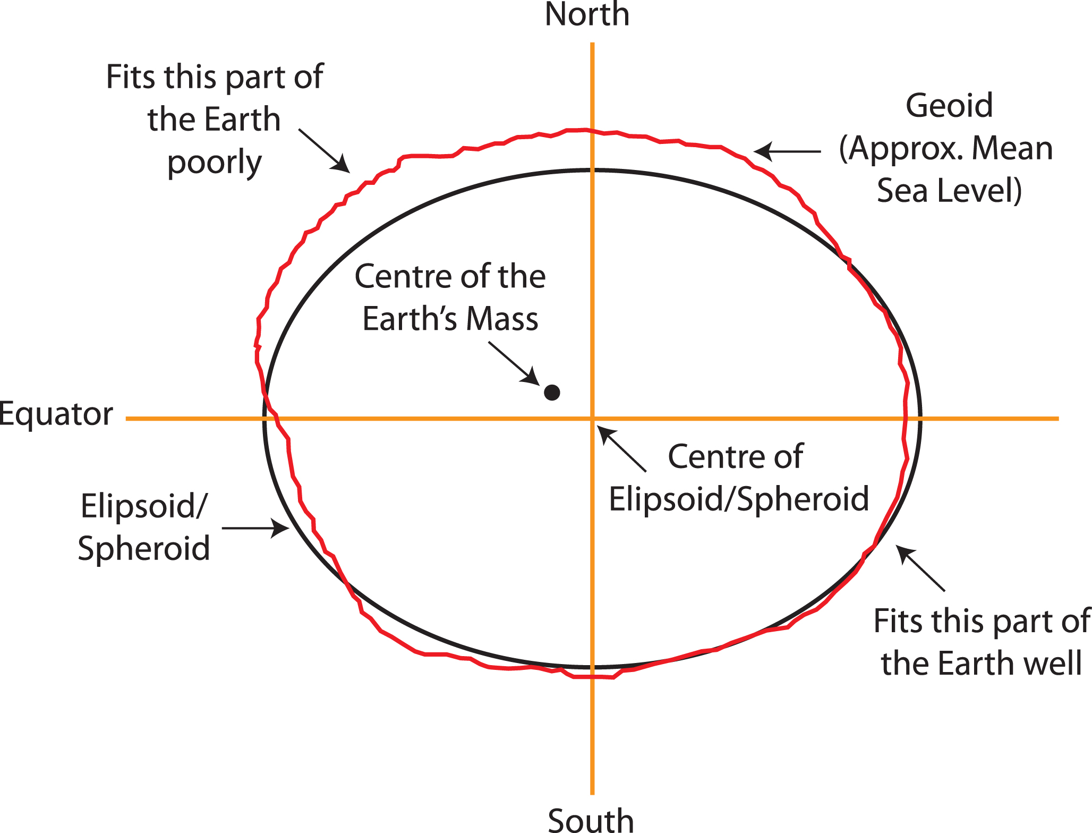
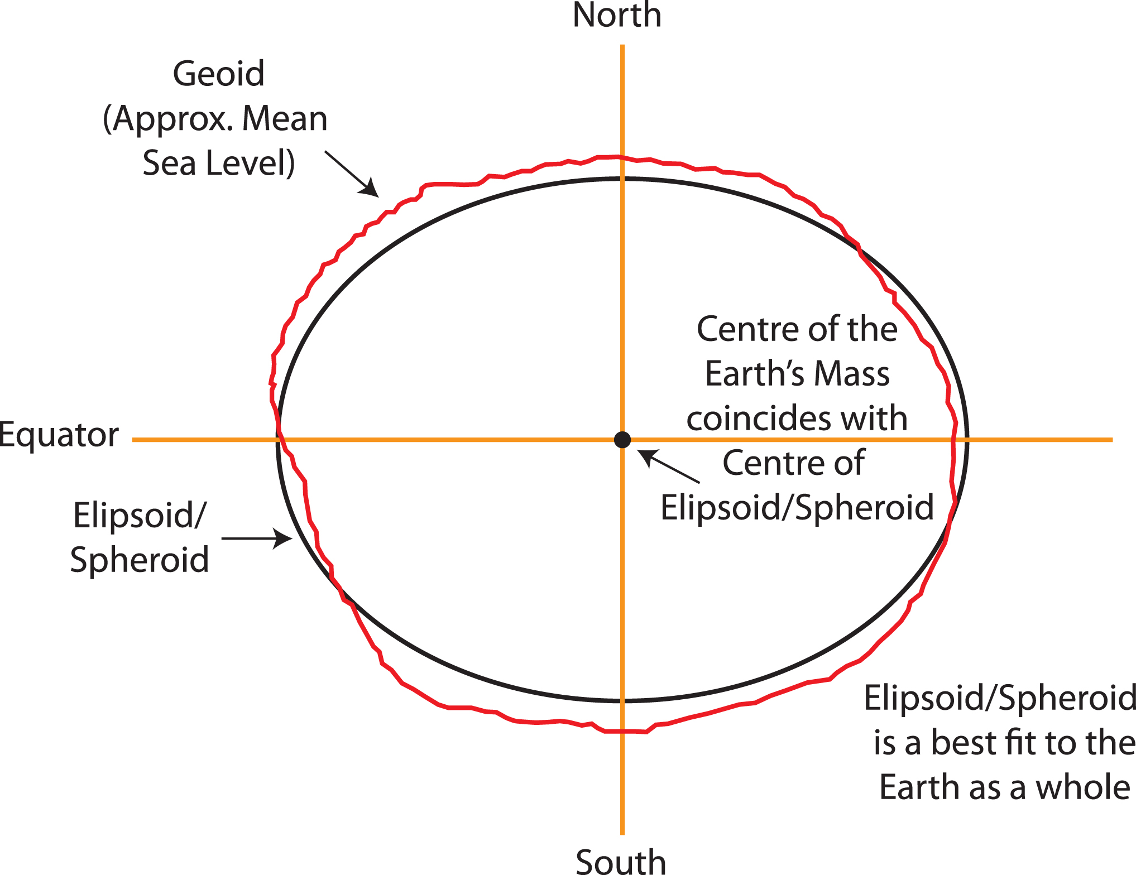
Datum
https://www.icsm.gov.au/education/fundamentals-mapping/datums

Slide 40
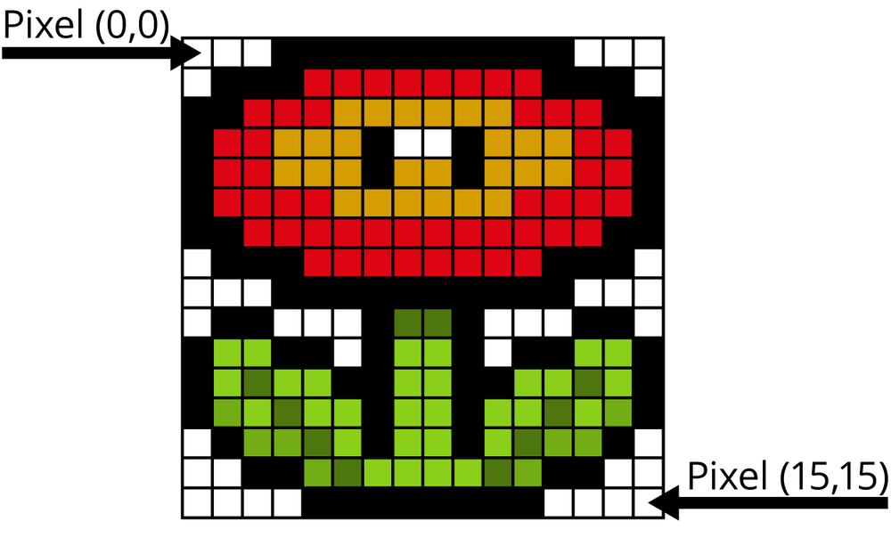
Spatial Reference Systems
A standardized method for assigning codes to locations so that locations can be found using the codes alone.
In a geospatial coordinate system, the x-direction value is the easting, and the y-direction value is the northing.
“Most” systems make both values positive.
https://www.oreilly.com/library/view/practical-computer-vision/9781449337865/ch04.html

Slide 41
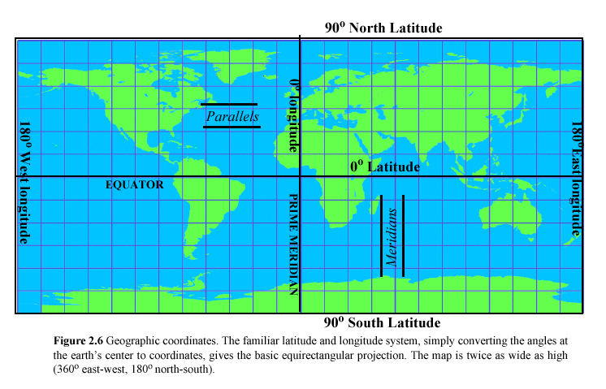
Geographic Coordinates
Geographic coordinates are the Earth's latitude and longitude system
ranging from 90 degrees south to 90 degrees north in latitude and 180 degrees west to 180 degrees east in longitude

Slide 42
Geographic Coordinates
Wait, how do we go from 3D ellipsoid to 2D maps?

Slide 43
Map Projections
A mathematical transformation of the spherical or ellipsoidal Earth onto a flat map
A projection that preserves the shape of features across the map is called conformal.
A projection that preserves the area of a feature across the map is called equal area or equivalent.
No flat map can be both equivalent and conformal. Most fall between the two as compromises.

Slide 44
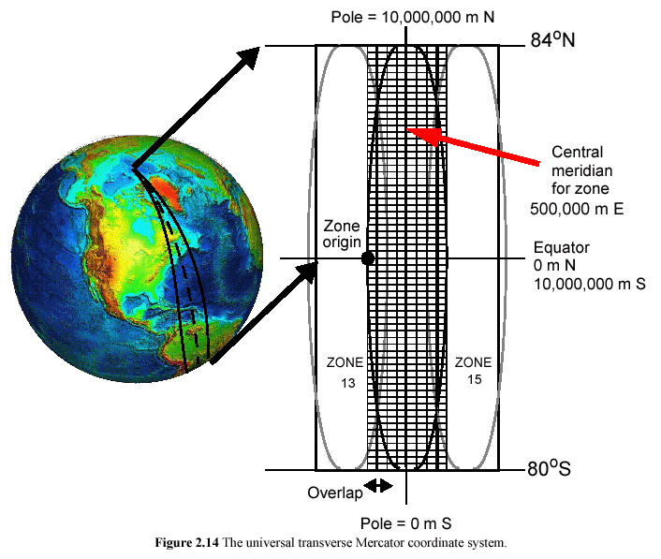
Universal Transverse Mercator (UTM)
Project a small piece of the 3D Earth to a 2D map
Small grids help compute distances and directions easily

Slide 45
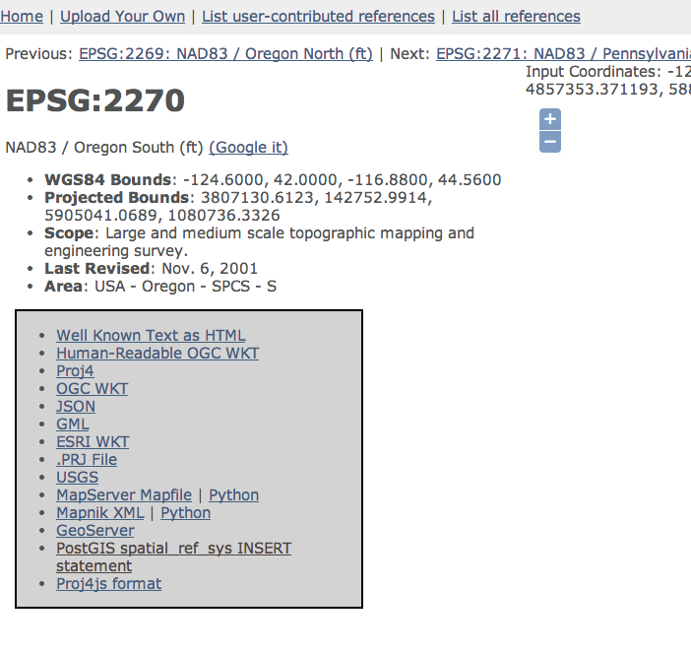
Spatial Reference System Identifier (SRID)
https://spatialreference.org/ref/

Slide 46
Spatial Query Language
Spatial data types, e.g., point, lines, polygon, …
Spatial operations, e.g., overlap, distance, nearest neighbor, …
Callable from a query language (e.g., SQL) of underlying DBMS
SELECT S.name
FROM Senator S
WHERE S.district.Area() > 300

Slide 47
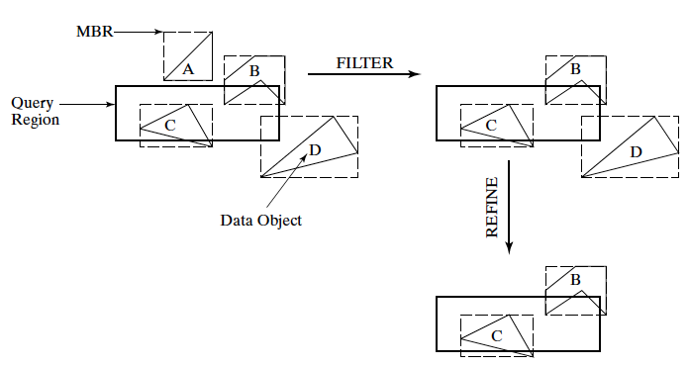
Spatial Index and Query Processing
Efficient algorithms to answer spatial queries
Common Strategy - filter and refine
Filter Step: Query Region overlaps with MBRs of B,C and D
Refine Step: Query Region overlaps with B and C

Slide 48
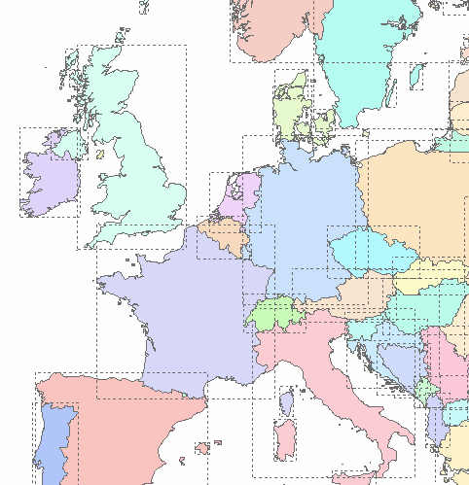
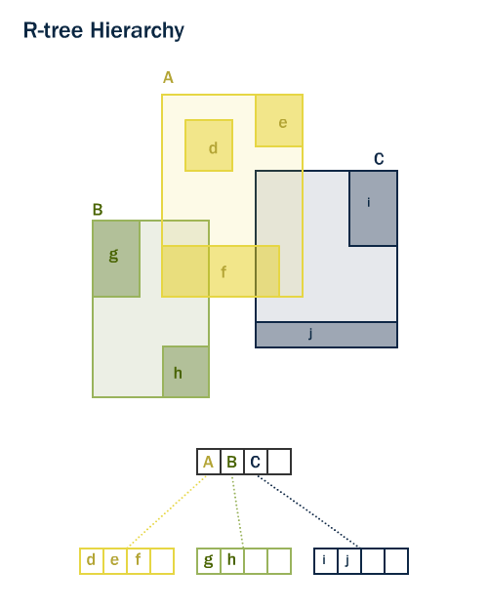
Spatial Index and Query Processing – R-tree

Slide 49
Example Queries
Fundamental spatial algebra operations
Spatial selection: returning those objects satisfying a spatial predicate with the query object
– “All cities in Bavaria”
SELECT sname FROM cities c WHERE c.center inside Bavaria.area
– “All rivers intersecting a query window”
SELECT * FROM rivers r WHERE r.route intersects Window
– “All big cities no more than 100 Kms from Hagen”
SELECT cname FROM cities c WHERE dist(c.center, Hagen.center) < 100 and c.pop > 500k
(conjunction with other predicates and query optimization)
Notes:
2018 w1

Slide 50
Example Queries…*
Spatial join: A join which compares any two joined objects based on a predicate on their spatial attribute values
“For each river pass through Bavaria, find all cities within less than 50 Km”
SELECT
r.rname, c.cname, length(intersection(r.route, c.area))
FROM rivers r, cities c
WHERE r.route intersects Bavaria.area and
dist(r.route,c.area) < 50 Km

Slide 51
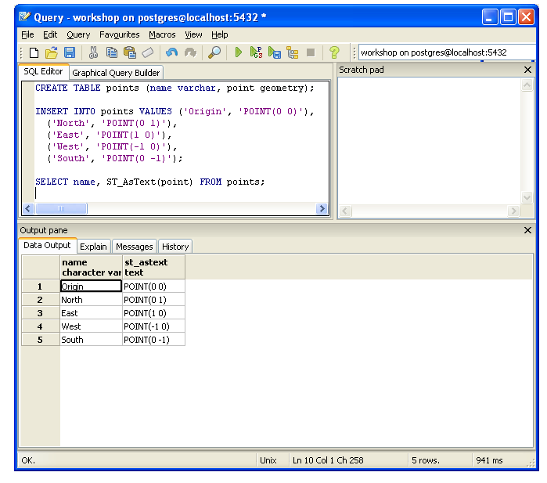
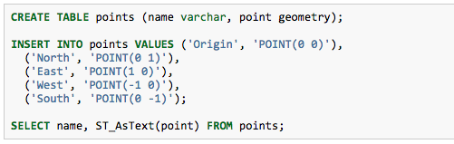
SFSQL Example

Slide 52
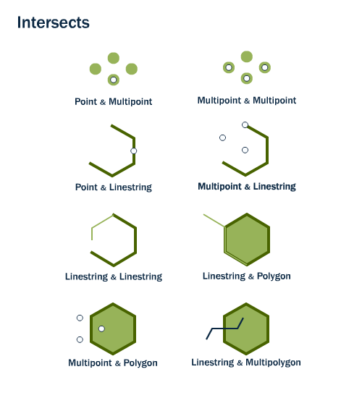
ST_Intersects
ST_Intersects(geometry A, geometry B) returns t (TRUE) if the two shapes have any space in common, i.e., if their boundaries or interiors intersect.

Slide 53
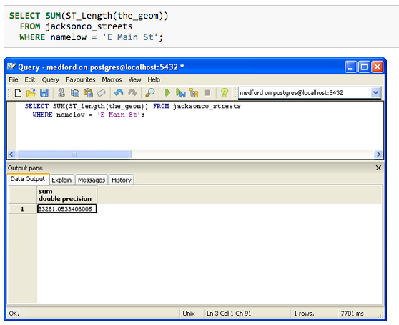
Query with SRID in Mind
The table “jacksonco_streets” has its SRID as 2270 (EPSG:2270: NAD83 / Oregon South (ft))
What is the unit here?
Notes:
2270 Oregon south (feet)

Slide 54
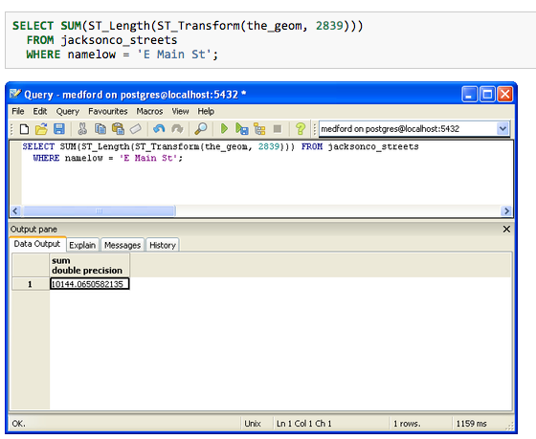
Query with SRID in Mind*
SRID 2389 is a metric projection so what is the unit here?
Notes:
meters

Slide 55
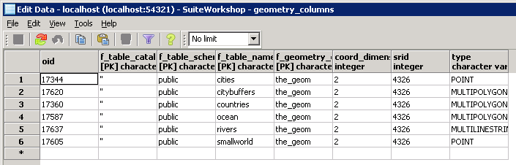
Geometry Columns
The geometry_columns view defines the dimension, geometry, and spatial reference system for each spatial table that contains a geometry type

Slide 56
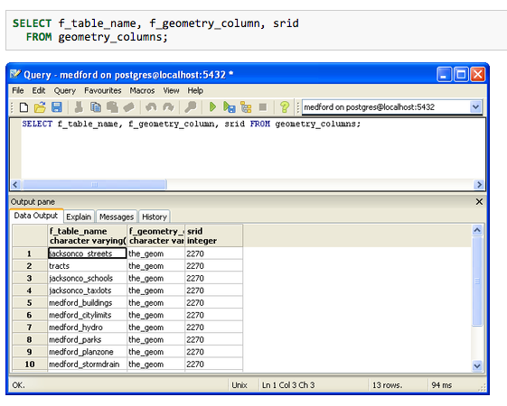
Geometry Columns*

Slide 57
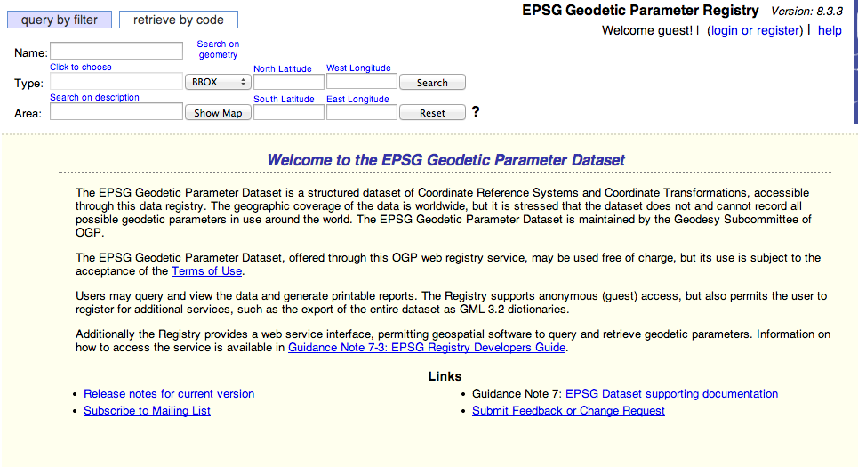
EPSG Registry

Slide 58
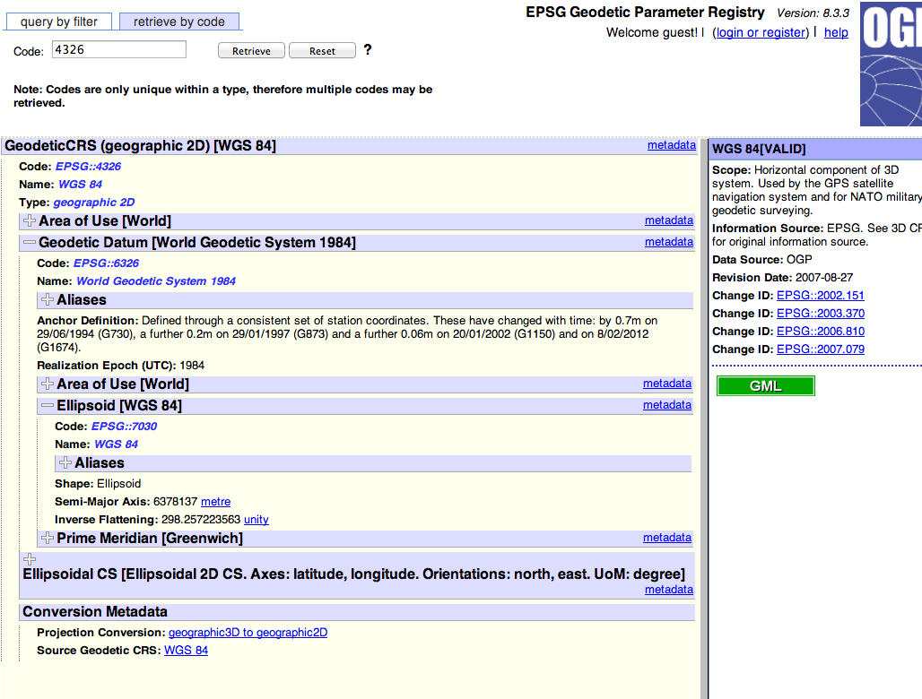
EPSG Registry*

Slide 59
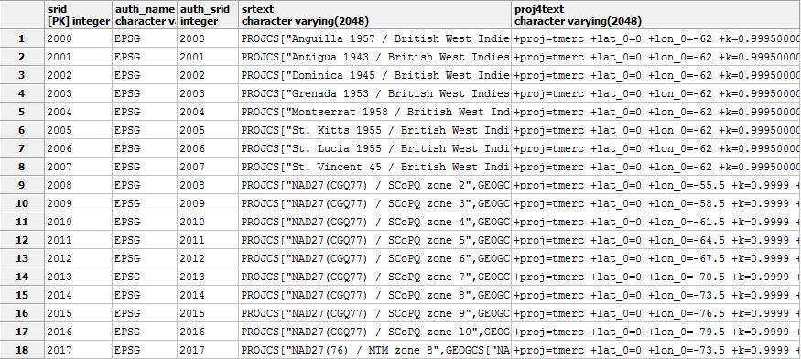
Coordinate System Support in Spatial Databases: spatial_ref_sys
Every Geometry Column is associated with a Spatial Reference System

Slide 60
Geography VS Geometry
The Geometry column type can hold geometric data of any type and in any (or no) projection and CRS.
not optimized for dealing with geodetic measurements (distances on the sphere)
The Geography type, (while able to handle geodetic measurements), are much more limited
there are fewer compatible functions when compared to Geometry

Slide 61
Summary
Effective spatial data management strategies can enable many spatial AI tasks
SDBMS is a software module
works with an underlying DBMS
provides spatial ADTs callable from a query language
provides methods for efficient processing of spatial queries (e.g., using index)
Components of SDBMS include
spatial data models, spatial data types, and operators
information about common spatial reference systems
spatial query language, processing, and optimization
Always handle spatial data with reference systems in mind!

Slide 62
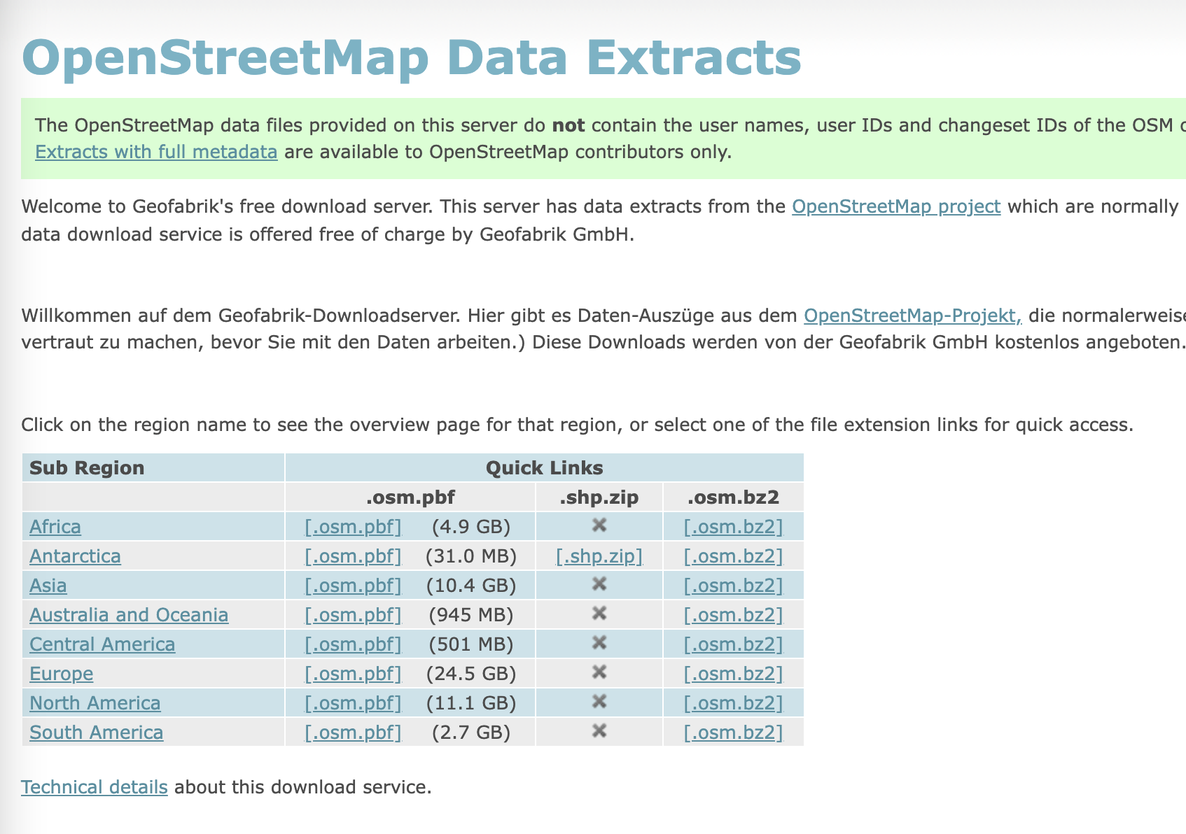
Spatial Data Can be Huge
How to deal with large spatial data?
Next time - MapReduce

Slide 63
Useful Resources
PostGIS Workshop: https://postgis.net/workshops/postgis-intro/
QGIS Tutorial: https://www.qgistutorials.com/en/

Slide 64
Acknowledgements
Gil, Yolanda (Ed.) Introduction to Computational Thinking and Data Science. Available from http://www.datascience4all.org
'image: Flaticon.com'. These slides have been designed using resources from Flaticon.com
This presentation was adapted from the slides provided from the textbook: Spatial Databases: A Tour. Authors: Shashi Shekhar and Sanjay Chawla. Publisher: Prentice Hall, 2003, from the database course slides provided by Cyrus Shahabi, from Hart Hartmut Guting’s VLDB Journal v3, n4, October 1994, from Boundless OpenGeo tutorial.
These slides are adapted from the slides provided by Keith Clarke from his course and textbook Getting Started with Geographic Information System, Prentice Hall and from Craig Knoblock

Slide 65

These materials are released under a CC-BY License
https://creativecommons.org/licenses/by/2.0/
You are free to:
Share — copy and redistribute the material in any medium or format
Adapt — remix, transform, and build upon the material
for any purpose, even commercially.
The licensor cannot revoke these freedoms as long as you follow the license terms.
Under the following terms:
Attribution — You must give appropriate credit, provide a link to the license,
and indicate if changes were made. You may do so in any reasonable manner,
but not in any way that suggests the licensor endorses you or your use.
Artwork taken from other sources is acknowledged where it appears.
Artwork that is not acknowledged is by the author.
Please credit as: Chiang, Yao-Yi Introduction to Spatial Artificial Intelligence. Available from https://yaoyichi.github.io/spatial-ai.html
If you use an individual slide, please place the following at the bottom: “Credit: https://yaoyichi.github.io/spatial-ai.html
We welcome your feedback and contributions.
Credit: http://www.datascience4all.org/

